Slide 1
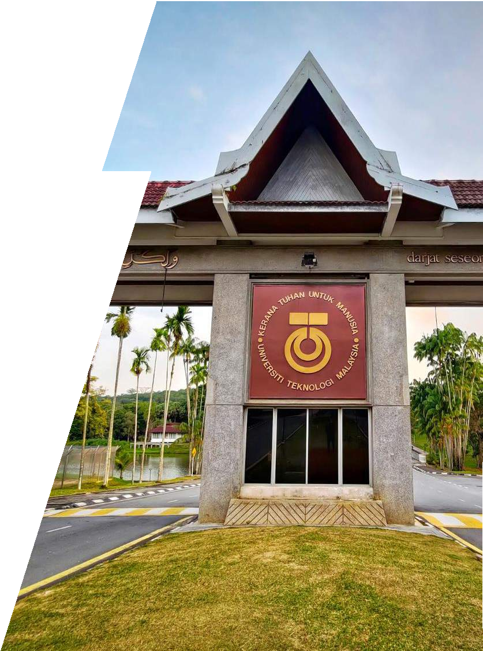
UNIVERSITI TEKNOLOGI MALAYSIA
U N DE RGR ADUATE AC ADE M IC AN D STU DE N TS AF FAIRS S ES S ION
DR NOR ZAFIR MD SALLEH
DEPUTY DEAN
ACADEMIC AND STUDENT AFFAIRS
UTM JOHOR BAHRU

Slide 3
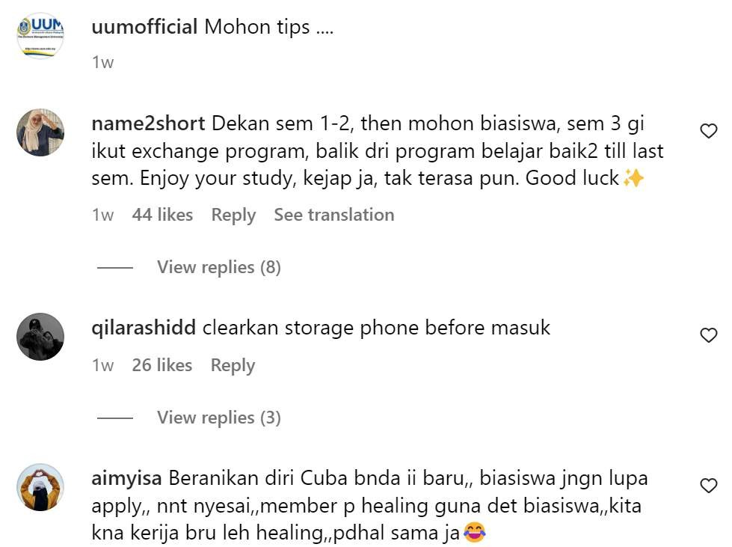
SENIOR TO JUNIOR TIPS TO SURVIVE UNIVERSITY

Slide 6
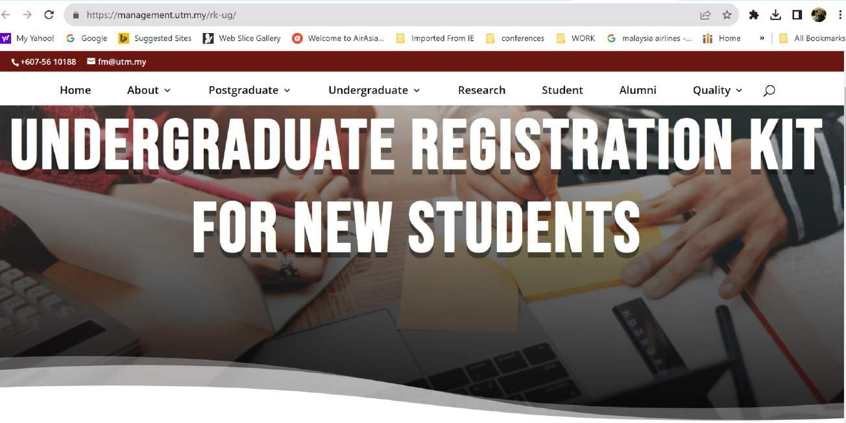
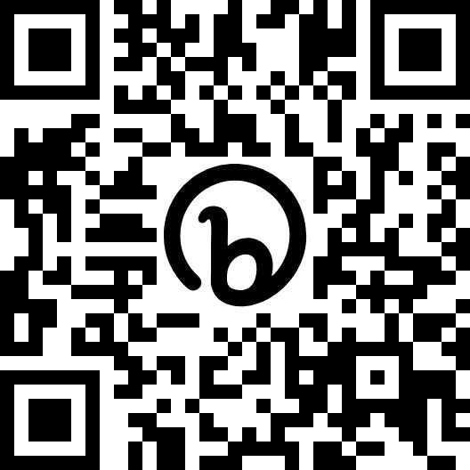
GET THE REGISTRATION KIT :
https://management.utm.my/rk-ug/
INNOVATING SOLUTIONS
6
INNOVATING SOLUTIONS

Slide 7
7

Slide 8
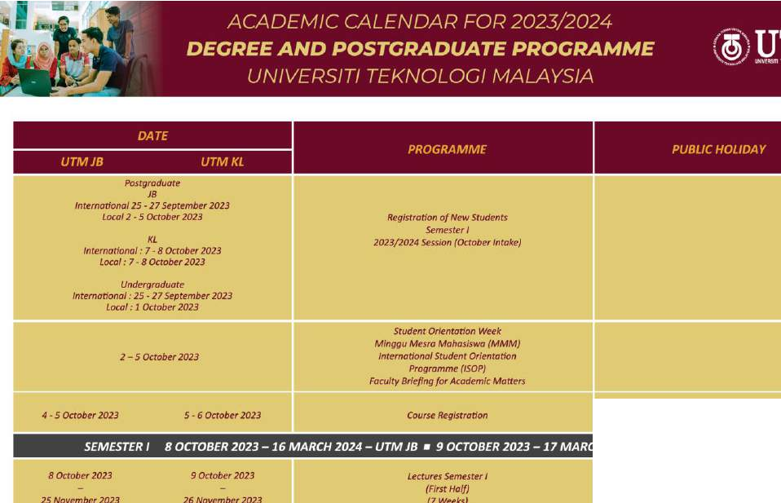
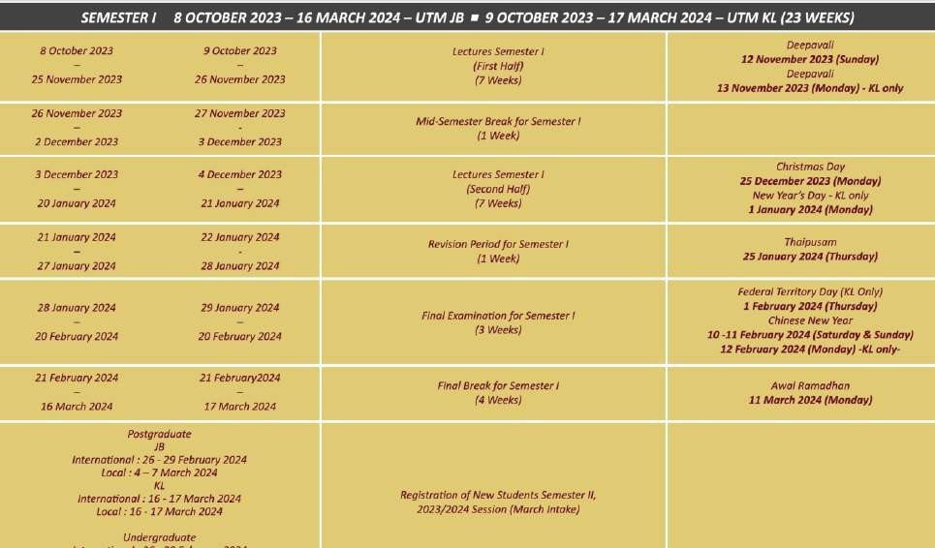

Slide 9
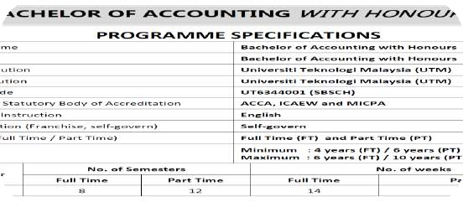
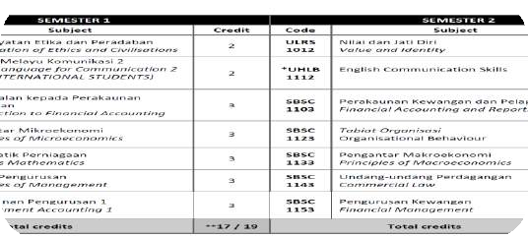
ACADEMIC HANDBOOK
PROGRAM SPECIFICATION
STUDY PLAN

Slide 10
Which stage are you now?
TIMELINE
In enim a arcu imperdiet malesuada. Fusce wisi. In enim a arcu imperdiet malesuada. Fusce wisi. In enim a arcu imperdiet malesuada. Fusce wisi. Nullam at arcu a est sollicitudin euismod. In Nullam at arcu a est sollicitudin euismod. In Nullam at arcu a est sollicitudin euismod. In convallis. Nullam dapibus fermentum ipsum. convallis. Nullam dapibus fermentum ipsum. convallis. Nullam dapibus fermentum ipsum.
Aliquam erat volutpat. Aliquam erat volutpat. Aliquam erat volutpat.
In enim a arcu imperdiet malesuada. Fusce wisi. In enim a arcu imperdiet malesuada. Fusce wisi. In enim a arcu imperdiet malesuada. Fusce wisi. Nullam at arcu a est sollicitudin euismod. In Nullam at arcu a est sollicitudin euismod. In Nullam at arcu a est sollicitudin euismod. In convallis. Nullam dapibus fermentum ipsum. convallis. Nullam dapibus fermentum ipsum. convallis. Nullam dapibus fermentum ipsum.
Aliquam erat volutpat. Aliquam erat volutpat. Aliquam erat volutpat.
INNOVATING SOLUTIONS 10

Slide 11
GET THE REGISTRATION KIT : https://management.utm.my/rk-ug/

Slide 12
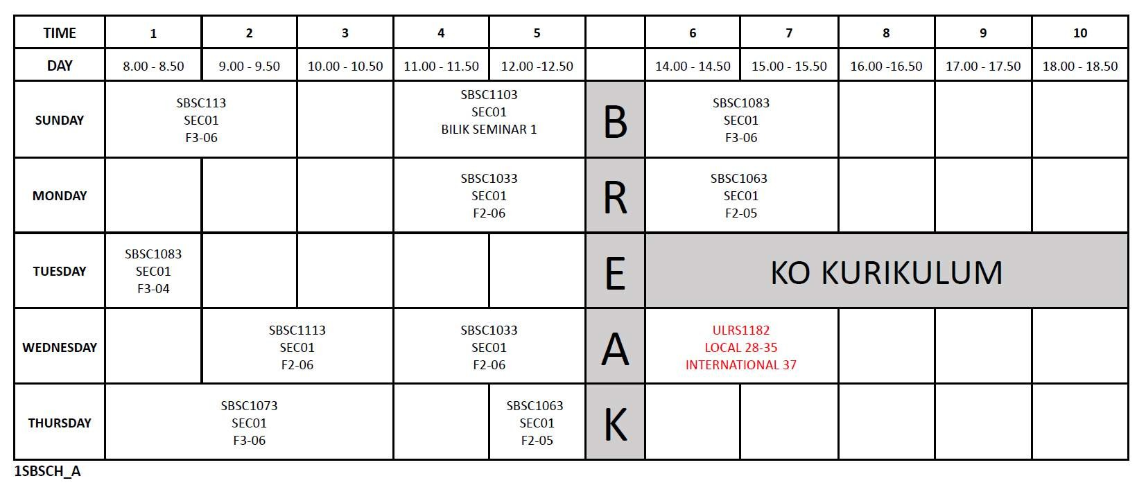
SUBJECT
CODE
SECTION CLASS
LOCATION
CO-CURRICULAR
CLASS/SECTION/BAT CH

Slide 13
FM Academic P r o g r a m s
2
4
3
DOCTORAL
MASTERS
UNDERGRADUATE
Doctor of Philosophy,
Field of Research : Management
Master of Management
(Specialization: Technology Management)
Bachelor of Management (Technology)
with Honours
Doctor of Philosophy, Field of Research: Information Systems
Master of Philosophy
Field of Research: Management
Bachelor of Management (Marketing)
with Honours
Master of Information Technology
(Specialization: Information Technology Management)
Bachelor of Accounting
with Honours
Master of Science (Information Technology Entrepreneurship)
6
3
UNDERGRADUATE PROGRAMS
POSTGRADUATE PROGRAMS
(2 PhD, 4 Master)
INNOVATING SOLUTIONS
13

Slide 14
Student’s Roles & Responsibilities
DO’s
Check and follow Academic Calendar for important dates such as course registration date, drop, withdrawal etc.
01
Discuss with academic advisor (AA) the study plan especially
courses to take for each semester
02
Register for all relevant courses (core and elective) with the
right code
03
04
Ensure that the total number of credits taken are correct
Attend the First Year Experience (FYE) program and UTM Professional Courses
05
Attend all registered classes, must attend more than 80% from overall hours for each courses
06
07
Create and develop e-Portfolio, for visibility.
INNOVATING SOLUTIONS

Slide 15
ACADEMIC PROGRAM BASED ON STUDENTS’
ACHIEVEMENTS AND ABILITIES
Our academic program consists of flexible modules which consider student ability:-
01
02
Credit Transfer
No. of semester:
7/8 Semesters (Normal) 12 Semesters (Maximum)
04
Grade Improvement (Ulang Gred – UG)
03
Redeem Subject
(Ulang Kursus – UK)
15
INNOVATING SOLUTIONS

Slide 16
ASSESSMENT SYSTEM
MARKS
GRADE
POINT VALUE
Continuous Assessment
90 - 100
A+
4.00
80 - 89
A
4.00
75 - 79
A-
3.67
Class Attendance
70 - 74
B+
3.33
Course work
65 - 69
B
3.00
Special Examination
60 - 64
B-
2.67
55 - 59
C+
2.33
Final
examination
50 - 54
C
2.00
45 - 49
C-
1.67
40 - 44
D+
1.33
35 - 39
D
1.00
FAIL
30 - 34
D-
0.67
00 - 29
E
0.00
16
INNOVATING SOLUTIONS

Slide 17
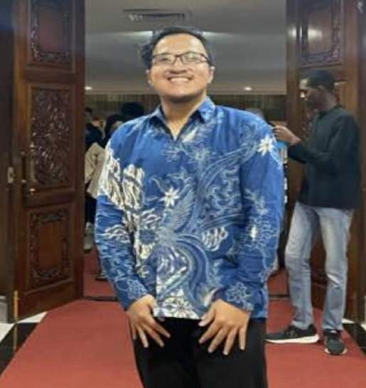
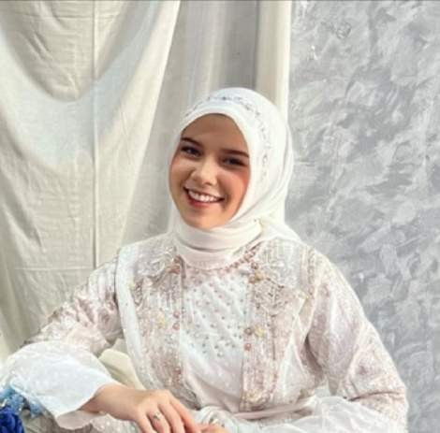
FAIL OR PASS?
Subject: Principle of Management
FARIZ
MARKS: 35
ALVINA
MARKS: 70
MAYA
MARKS: 45
INNOVATING SOLUTIONS
17

Slide 18
ACADEMIC STANDING
The student's academic standing is based on GPA (Grade Point Average) and CGPA (Cumulative Grade Point Average) calculated based on h i s achievement in all registered courses in any particular semester. Each grade is changed to point based on the formulation below:
Point
= Course credit x Point value
= Total Points
Total credits for the particular semester
= Total points as a whole
ACADEMIC STANDING | CGPA
Good Standing (Kedudukan Baik - KB) | CGPA > 2.00
Probationary Standing (Kedudukan Bersyarat - KS) | 1.70 < CGPA < 2.00
Failure Standing (Kedudukan Gagal - KG) | CGPA < 1.70
GPA
(Grade Point Average)
CGPA
(Cumulative
Grade Point Average)
Total credits as a whole
18
INNOVATING SOLUTIONS

Slide 19
I.
Students who obtained Failure Standing (KG) OR Probationary Standing (KS) 3 times in a row will be terminated.
Student who obtained GPA <1.00 even with CGPA ≥ 1.70,
with Senate approval may:
Continue their studies OR
Be asked to defer their studies to the following semester OR
Be terminated from their studies.
INNOVATING SOLUTIONS
19

Slide 20
WITHDRAWAL (TARIK DIRI -TD)
Students with the approval of the lecturer and as agreed by Academic Advisor may request for a withdrawal from any of the courses registered
Application for courses withdrawal may be done not later than the last day of working in Week 8 of the respective semester
INNOVATING SOLUTIONS
20

Slide 21
CLASS ATTENDANCE
A student’s class attendance for a particular course must be more than 80% from the overall hours
If a student is absent more than 20% from the overall hours without a valid reason, the faculty can take action according to the University’s rules; eg: he/she may be barred from final examination*
*Not applicable for Online Final Examination
21
INNOVATING SOLUTIONS

Slide 22
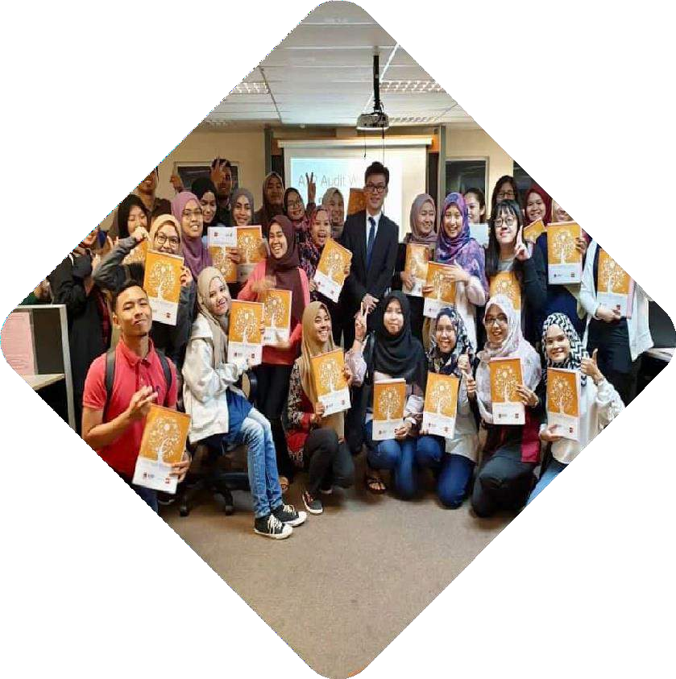
ACADEMIC ADVISORY SYSTEM
Each UG student is put under the supervision of an Academic Advisor who is an academic staff member from the student’s own faculty.
To assist students in understanding institutional policies, procedures and regulations
To provide information on academic program, institutional support
services and resources
To assist students in planning, monitoring and evaluating their educational
plan towards degree completion and developing decision-making skills
To assist students in determining their career goals
To assist students in developing their intellectual, personal and social
development
22
INNOVATING SOLUTIONS

Slide 23
ACADEMIC ADVISORY SYSTEM
“Academic advising also assists students to realise the maximum educational benefits available to them by helping them to better understand themselves and to learn to use resources of the institutions to meet their educational needs”
Academic matters
Stress / Emotional challenges
Financial
challenges
Personal / Social challenges
* Crockett, David S. (1984) “ACT as strategic resource in enhancing the advising process’, NACADA Journal 4(2):1-11.
23
INNOVATING SOLUTIONS

Slide 24
UTM STUDENT DRESS CODE
01
₀₂ 04
03
INNOVATING SOLUTIONS
24

Slide 25
Academic Awards
DEAN’S LIST
CGPA 3.67 or above
At least 12 credit hours
Excluding courses with status Hadir Sahaja (HS), Hadir Wajib (HW), Ulang Gred (UG), dan Ulang
Kursus (UK)
By semester
ROYAL EDUCATION AWARD*
Final semester / graduate
VICE-CHANCELLOR AWARD*
Final semester / graduate
ACADEMIC EXCELLENCE AWARD
CGPA 4.00
Final semester/
graduate
NO disciplinary misconduct (apply to all)
*CGPA 3.5 or 3.67 and above
(different for each Awards)
*50% Academic achievement
*25% Academic activities
*25% Co-curricular activities
ACCA ACADEMIC EXCELLENCE AWARD*
Bach. of Accounting graduate only
TUN FATIMAH HJ HASHIM GOLD EXCELLENCE AWARD*
Female graduate only
ALUMNI AWARD*
Final semester / graduate
INNOVATING SOLUTIONS
25

Slide 26
JOIN OUR GROUPS/ CHANNELS TO GET LATEST UPDATES:
SBSCH
Bachelor of Accounting with Honours
SFMDH
Bachelor of Management (Technology) with Honours
SBSFH
Bachelor of Management (Marketing) with Honours
Kindly please join us through this link:
https://t.me/fmutmaccounting
https://t.me/fmutmtechnology
https://t.me/fmutmmarketing
https://chat.whatsapp.com/KuE zkA15lu1CX8y4H1MrOd
https://chat.whatsapp.com/DT Xn7bjIfyO2V5eh0yMC4T
https://chat.whatsapp.com/EyS2 ywGO3CyDDI9rtvvO1B
Kindly contact us (msyazli@utm.my) to add you to this Google Mail Groups:
fm-accountingstudent-
group@utm.my
fm-technologystudent-
group@utm.my
fm-marketingstudent- group@utm.my
INNOVATING SOLUTIONS
26

Slide 27
Join your program’s Telegram Channel now
To all current and new students of Faculty of
Management UTM, let’s get connected.
MARKETING : https://t.me/fmutmarketing
ACCOUNTING: https://t.me/fmutmaccounting
Don’t miss all the important news and updates!
TECHNOLOGY:https://t.me/fmutmtechnology
INNOVATING SOLUTIONS 27

Slide 28
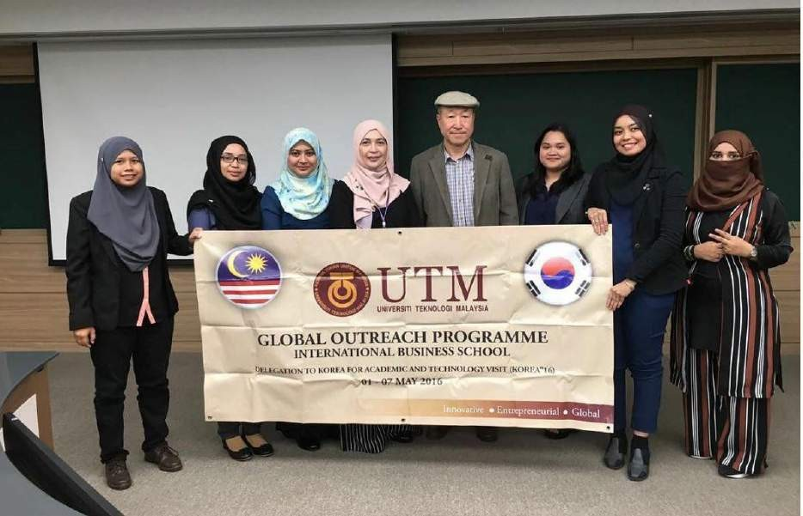
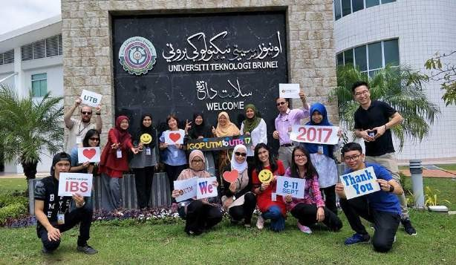
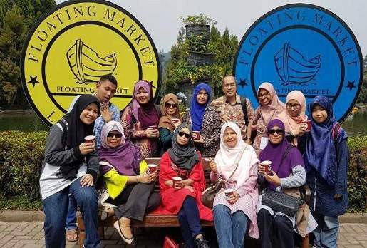
Student Mobility Program
Short Term (GOP, IIP & Summer School Abroad
Students are attach to universities abroad for Academic Visit, paper presentation, cultural /leadership camp and register any courses offered by host institutions
/ faculties during summer holiday
Global Mobility Programs
Study Abroad/ Student Exchange
Spend one or two semesters at universities abroad take courses in a regular semester with credit transfer opportunity OR students join research to join research study or internship under the supervision of an academic staff at universities or industries.
Exchange (NGS)
Spend one or two semesters take courses in a regular semester with credit transfer or
to join research study or internship
under the
supervision of an academic staff in
UTM.
INNOVATING SOLUTIONS
28
INNOVATING SOLUTIONS

Slide 29
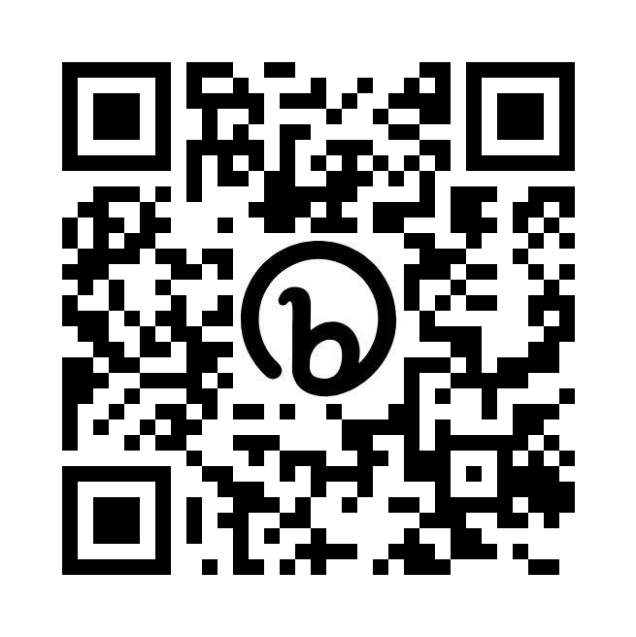
SUPPORT OUTBOUND MOBILITY TO JAPAN 30 NOVEMBER – 5 DECEMBER 2023
OUTBOUND MOBILITY
Pre-order is open until 15 Oct 2023
‼️ Grab yours now and look cool
😎 in the
Faculty Jersey
If you are interested, please fill in this link:
https://forms.gle/hkn1KEco4MEB GNM99
http://bit.ly/3tg1MV9
INNOVATING SOLUTIONS
29

Slide 30
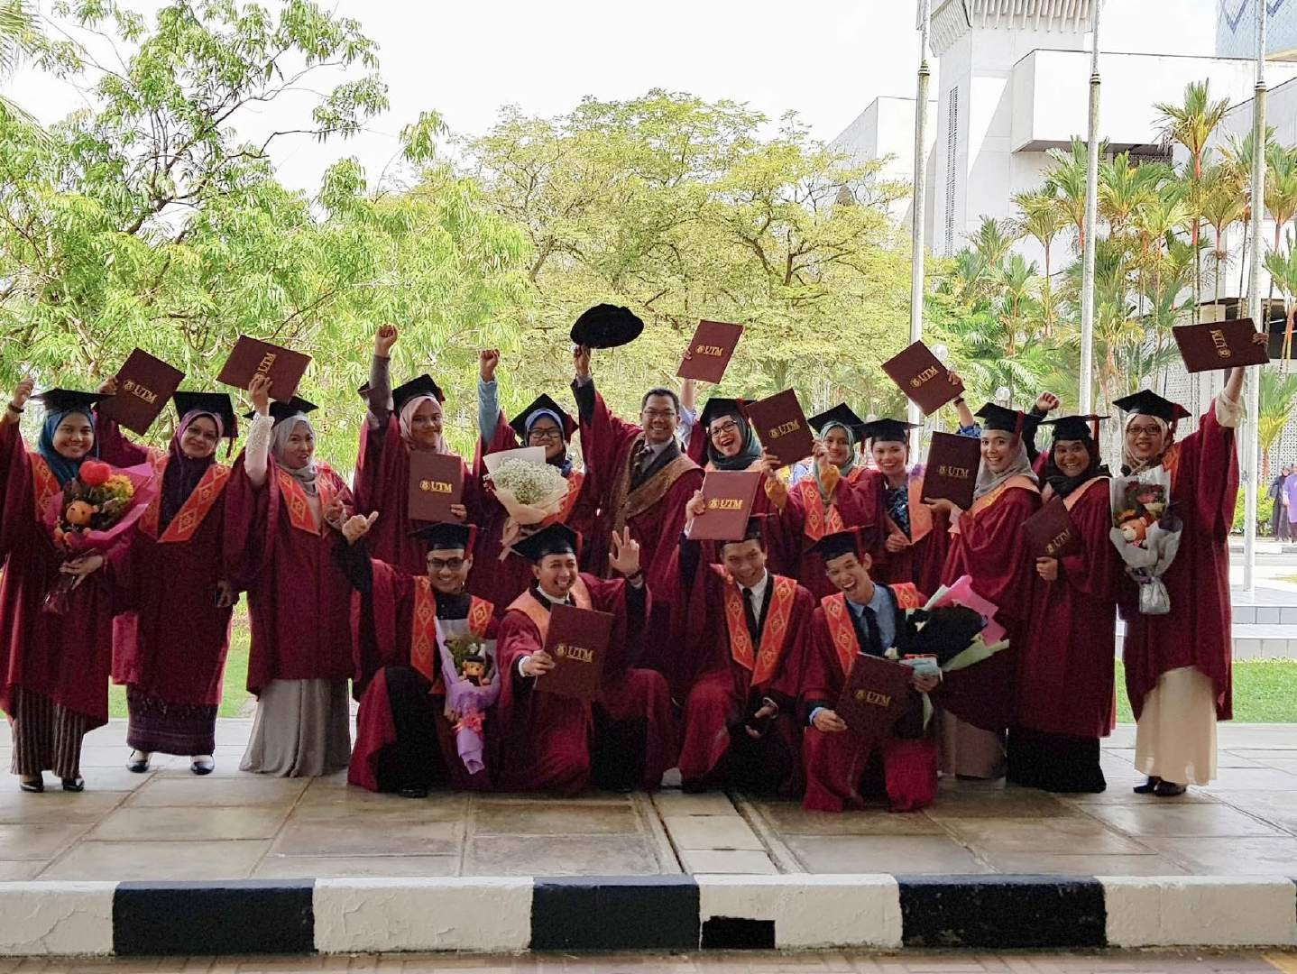
Faculty of Management fm_utm
faculty management utm
INNOVATING SOLUTIONS

